Slide 1

IS-201 - Database Chapter 4 – Intermediate SQL
Part(1) of (4): Join Expressions
DAW MAY THU KYAW
LECTURER
Faculty of Information Science

Slide 2
Joined Relations
Join operations take two relations and return as a result another relation.
A join operation is a Cartesian product which requires that tuples in the two relations match (under some condition). It also specifies the attributes that are present in the result of the join
The join operations are typically used as subquery expressions in the from clause
Three types of joins:
Natural join
Inner join
Outer join

Slide 3
Natural Join in SQL
Natural join matches tuples with the same values for all common attributes, and retains only one copy of each common column.
List the names of instructors along with the course ID of the
courses that they taught
select name, course_id from students, takes where student.ID = takes.ID;

Slide 4
Natural Join in SQL(Cont.)
Same query in SQL with “natural join” construct
select name, course_id
from student natural join takes;
The from clause can have multiple relations combined using natural join:
select A₁, A₂, … A_{n} from r₁ natural join r₂ natural join .. natural join r_{n} where P ;

Slide 5
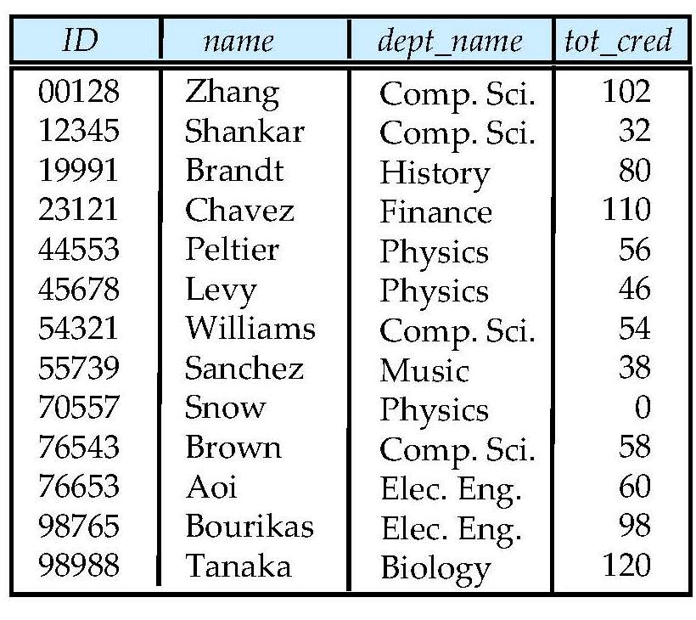
Student Relation

Slide 6
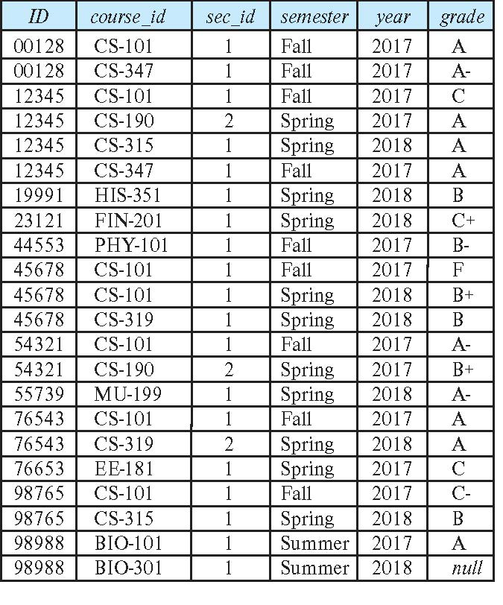
Takes Relation

Slide 7
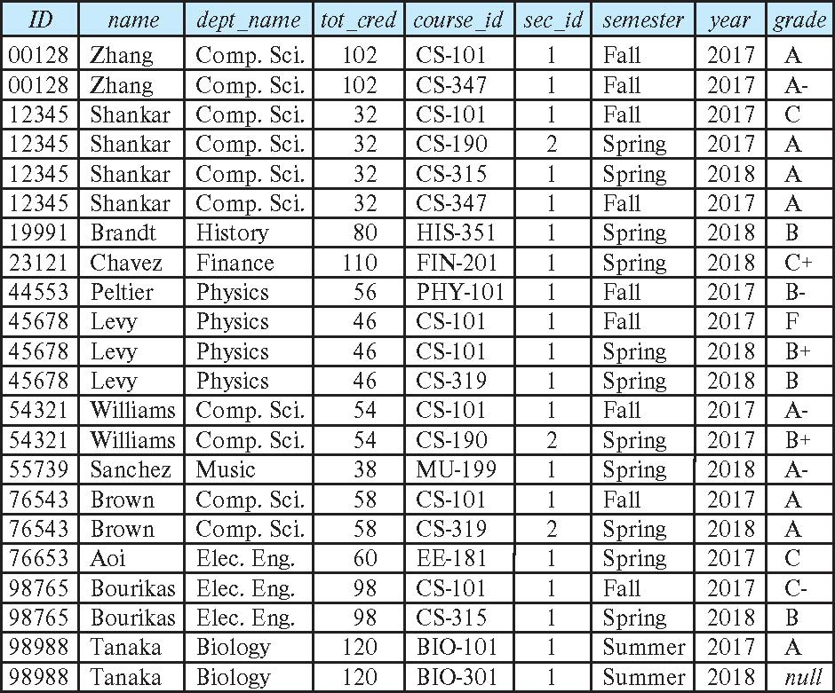
student natural join takes

Slide 8
Dangerous in Natural Join
Beware of unrelated attributes with same name which get equated incorrectly
Example -- List the names of students instructors along with the titles of courses that they have taken
Correct version
select name, title from student natural join takes, course where takes.course_id = course.course_id;

Slide 9
Dangerous in Natural Join(Cont.)
Incorrect version
select name, title from student natural join takes natural join course;
This query omits all (student name, course title) pairs where the student takes a course in a department other than the student's own department.
The correct version (above), correctly outputs such pairs.

Slide 10
Natural Join with Using Clause
To avoid the danger of equating attributes erroneously, we can use the “using” construct that allows us to specify exactly which columns should be equated.
Query example
select name, title from (student natural join takes) join course using (course_id)

Slide 11
Join Condition
The on condition allows a general predicate over the relations being joined
This predicate is written like a where clause predicate except for the use of the keyword on
Query example
select * from student join takes on student_ID = takes_ID
The on condition above specifies that a tuple from student matches a tuple from takes if their ID values are equal.

Slide 12
Join Condition(Cont.)
Equivalent to:
select * from student , takes where student_ID = takes_ID
The on condition allows a general predicate over the relations being joined.
This predicate is written like a where clause predicate except for the use of the keyword on.

Slide 13
Join Condition (Cont.)
Query example
select * from student join takes on student_ID = takes_ID
The on condition above specifies that a tuple from student matches a tuple from takes if their ID values are equal.
Equivalent to:
select * from student , takes where student_ID = takes_ID

Slide 14
Outer Join
An extension of the join operation that avoids loss of information.
Computes the join and then adds tuples form one relation that does not match tuples in the other relation to the result of the join.
Uses null values.
Three forms of outer join:
left outer join
right outer join
full outer join

Slide 15
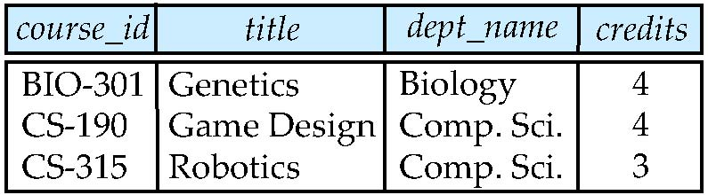
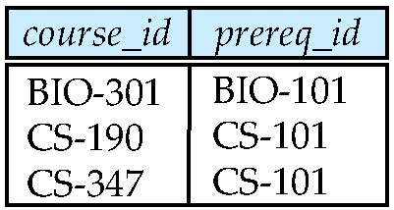
Outer Join Examples
Relation course
Relation prereq
Observe that
course information is missing CS-437
prereq information is missing CS-315
x

Slide 16
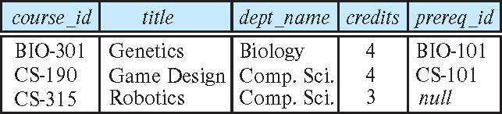
Left Outer Join
course natural left outer join prereq
In relational algebra: course ⟕ prereq

Slide 17
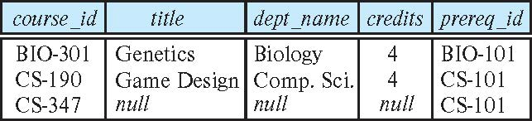
Right Outer Join
course natural right outer join prereq
In relational algebra: course ⟖ prereq

Slide 18
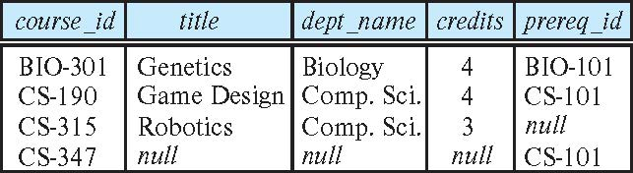
Full Outer Join
course natural full outer join prereq
In relational algebra: course ⟗ prereq

Slide 19
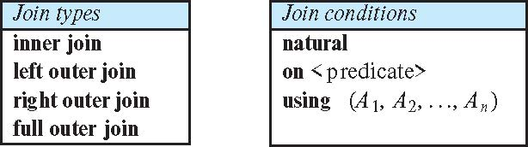
Joined Types and Conditions
Join operations take two relations and return as a result another relation.
These additional operations are typically used as subquery expressions in the from clause
Join condition – defines which tuples in the two relations match.
Join type – defines how tuples in each relation that do not match any tuple in the other relation (based on the join condition) are treated.

Slide 20
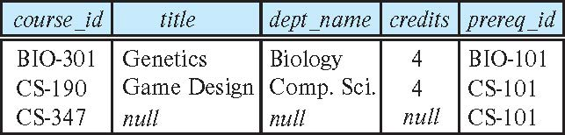
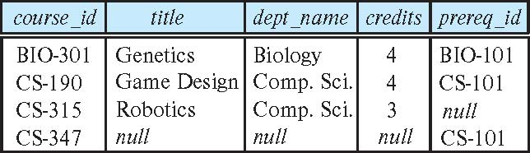
Joined Relations – Examples
course natural right outer join prereq
course full outer join prereq using (course_id)

Slide 21
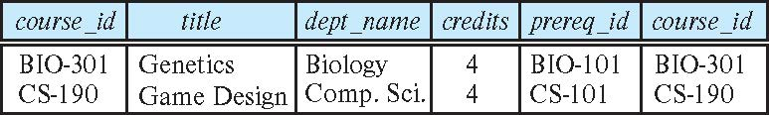
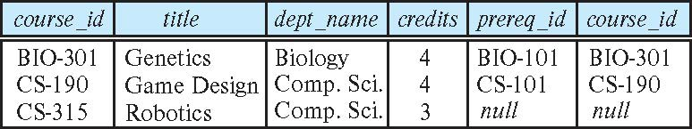
Joined Relations – Examples
course inner join prereq on course.course_id = prereq.course_id
What is the difference between the above, and a natural join?
course left outer join prereq on course.course_id = prereq.course_id

Slide 22
Joined Relations – Examples
course natural right outer join prereq
course full outer join prereq using (course_id)

Slide 23
Next Lecture
Views

